Slide 1






Malware Traffic Analysis Using MTAD
Diego Lopez, Ricky Li Ruan, Rithika Mathew, Saul Poveda, Aaroha Sapkota, Noelle D'Arcy
Notes:
Diego

Slide 2
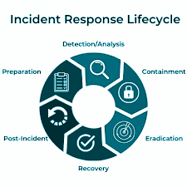

OUR MISSION
Our focus on this project is to be able to follow a
PLAYBOOK

Slide 3

Introduction
Malware traffic analysis is essential for uncovering the who, what, where, and when of malware activity, revealing how threats propagate and interact within a network.
It serves as a critical first step in detecting threats and alerting response teams swiftly.

Slide 4

IN THIS PRESENTATION:
MTAD Dataset and “Malwhere?!” Playbook
Utilized Tools
Wireshark
VirusTotal
NetworkMiner
Data Analysis of MTAD dataset
Incident Response

Slide 5
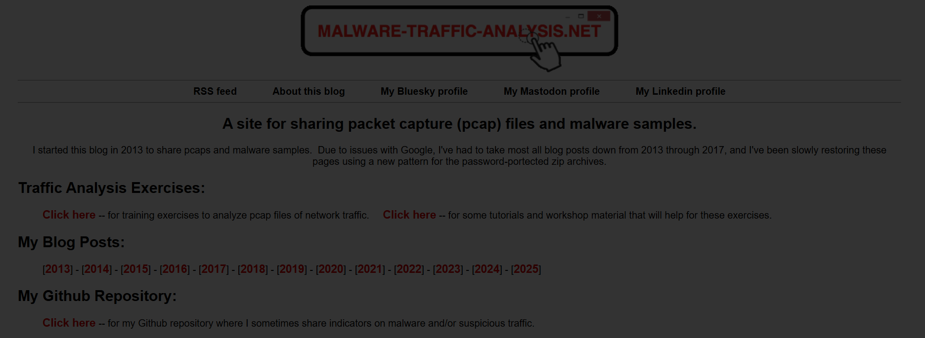
Dataset Overview
What is the MTAD Dataset (2025-01-22)?
The Malware Traffic Analysis Dataset (MTAD) is a collection of network traffic captures designed for cybersecurity research. It contains both malicious and benign traffic, enabling the study of malware behavior and intrusion detection techniques.

Slide 6
Dataset Overview
Types of Malware Included
Ransomware
Trojans
Botnets
Spyware
Adware
Source of the Data
Public cybersecurity repositories
Real-world and simulated malware infections
Network traffic captures (PCAPs) from controlled environments
Contributions from security researchers

Slide 7
Dataset Overview
Why This Dataset Was Chosen?
Comprehensive: Covers multiple malware families and attack patterns
Realistic: Includes authentic network traffic from real and simulated attacks
Deep Traffic Analysis: Identifies indicators of compromise (IOCs) like unusual patterns or attack signatures.

Slide 8
Playbook Selection
Which Playbook Was Used?
Malwhere!? (Our own playbook made specially for the dataset).
Best Option: Justification for the Choice
Tailored for MTAD Dataset: Designed specifically for malware traffic analysis
Covers Key Phases: Detection, containment, eradication, and recovery
Widely Used Framework: Based on standard cybersecurity incident response models like NIST and IltaNet playbooks.
Aligns with Network Traffic Analysis: Focuses on identifying malware through packet captures (PCAPs)

Slide 9
Tool Used
Wireshark
Why Chosen: Powerful network protocol analyzer; widely used in cybersecurity.
Use: Analyzed PCAP files to identify suspicious packet behavior, protocol anomalies, and connections to malicious domains.
VirusTotal
Why Chosen: Centralized malware analysis tool that aggregates results from 70+ antivirus engines.
Use: Uploaded SHA256 hashes of suspicious files found in HTTP traffic to verify if they were known malware.
NetworkMiner
Why Chosen: Great for passive network analysis and extracting forensic artifacts.
Use: Reconstructed downloaded files, extracted credentials, hostnames, and session data from PCAPs to trace malware activity.
Notes:
Wireshark was selected because it's a powerful network protocol analyzer that allows deep inspection of packet-level data. We used it to analyze PCAPs from the MTAD dataset to detect unusual traffic patterns, protocol anomalies, and communication with potentially malicious domains.
VirusTotal was chosen as a trusted malware analysis platform that aggregates results from over 70 antivirus engines. We used it to scan suspicious files by uploading their SHA256 hashes extracted from the network traffic, helping verify if a file was known malware.
NetworkMiner was used for its ability to reconstruct files and extract artifacts like images, credentials, and host details directly from PCAPs. This made it easier to trace malware behavior, identify compromised systems, and observe how the malware communicated with external servers.

Slide 10
Hypothesis
What was expected from data analysis:
Anticipated clear indicators of malware activity within the network traffic, such as communication with known malicious IP addresses or domains, unusual spikes in outbound or encrypted traffic, and consistent patterns reflecting specific malware behavior (e.g., ransomware, botnet infections).
Expected to identify specific attack patterns, including phishing attacks leading to credential theft, ransomware encrypting and exfiltrating data, and botnets attempting unauthorized control of IoT devices or other compromised hosts.

Slide 11
Data Analysis & Findings
Notes:
Saul

Slide 12
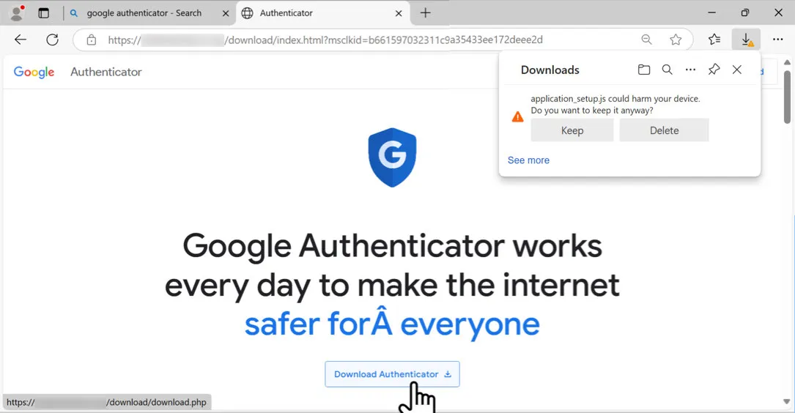
Dataset: 2025-01-22 Download from Fake Software Site

Slide 13
Background
An employee at bluemoontuesday.com searched for Google Authenticator (a security app) but was tricked into downloading malware instead.
Received report about a coworker downloading suspicious file after search Google Authenticator.
Caller provided information about similar situations.

Slide 14
Type of Attack:
Malvertising: Malicious advertisements that appear in search results or on legitimate ad networks, tricking users into downloading malware by mimicking trusted tools like Google Authenticator.
Typosquatting: The malicious site may use a deceptive domain name that closely resembles a legitimate one (e.g., authenticatoor.com instead of authenticator.google.com) to increase its credibility.
Command and Control (C2): After the fake app is installed, it may establish communication with an attacker-controlled server to exfiltrate data or receive further instructions, indicating C2 activity.

Slide 15
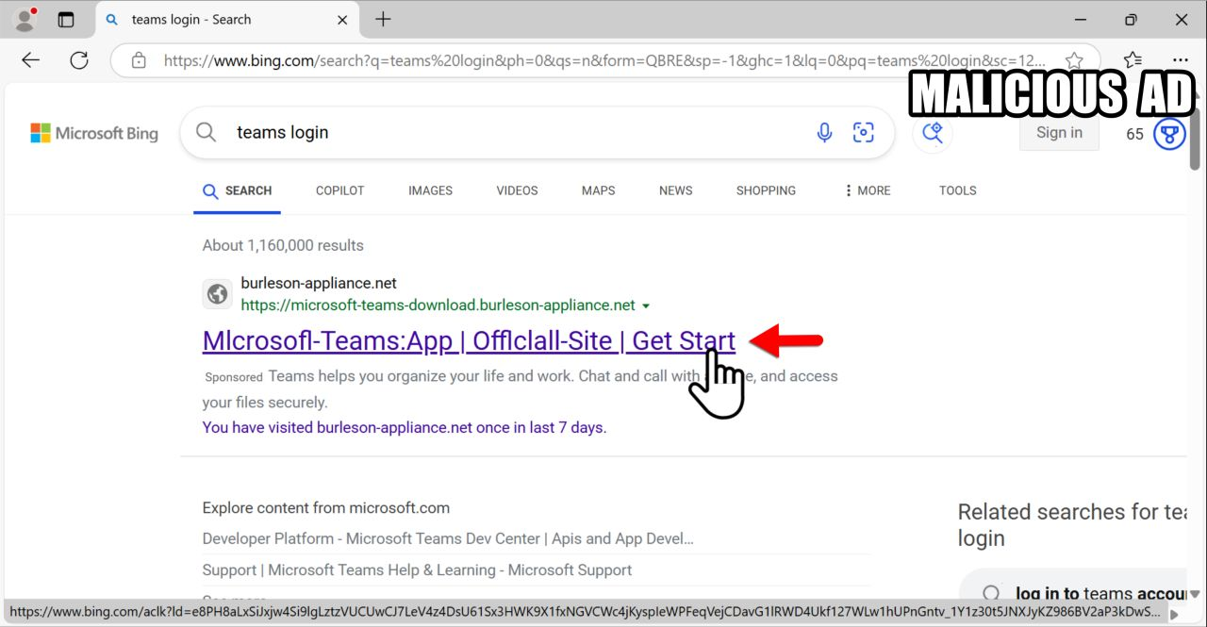
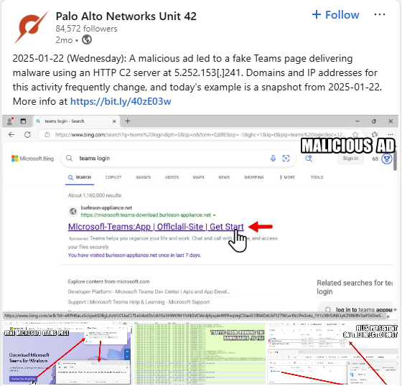
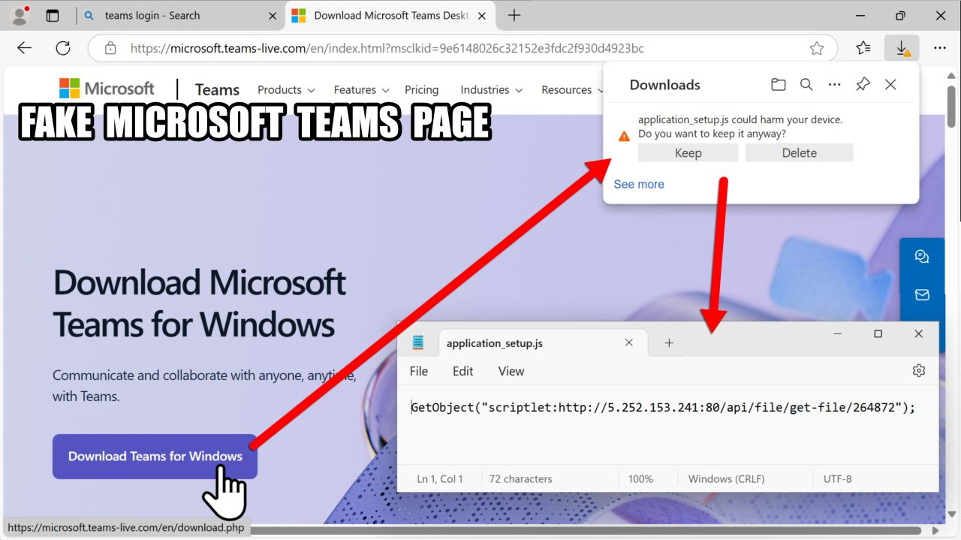
Social Media Links

Slide 16
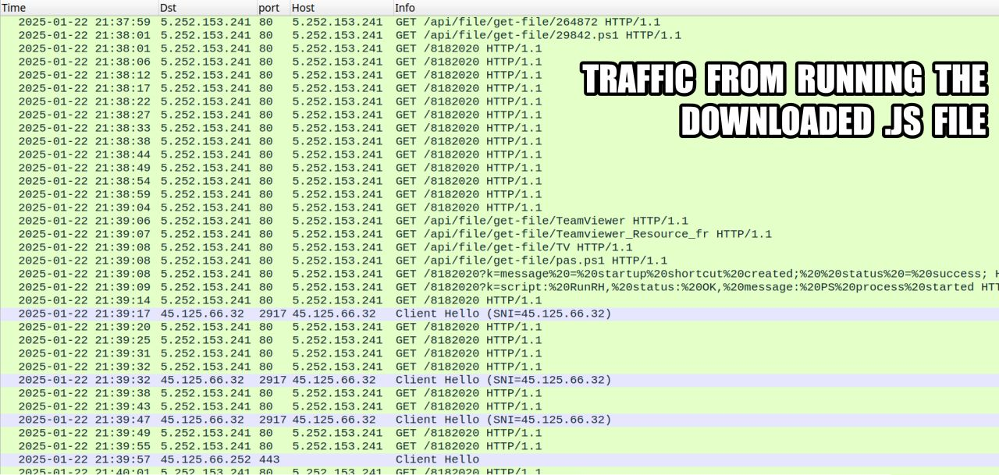
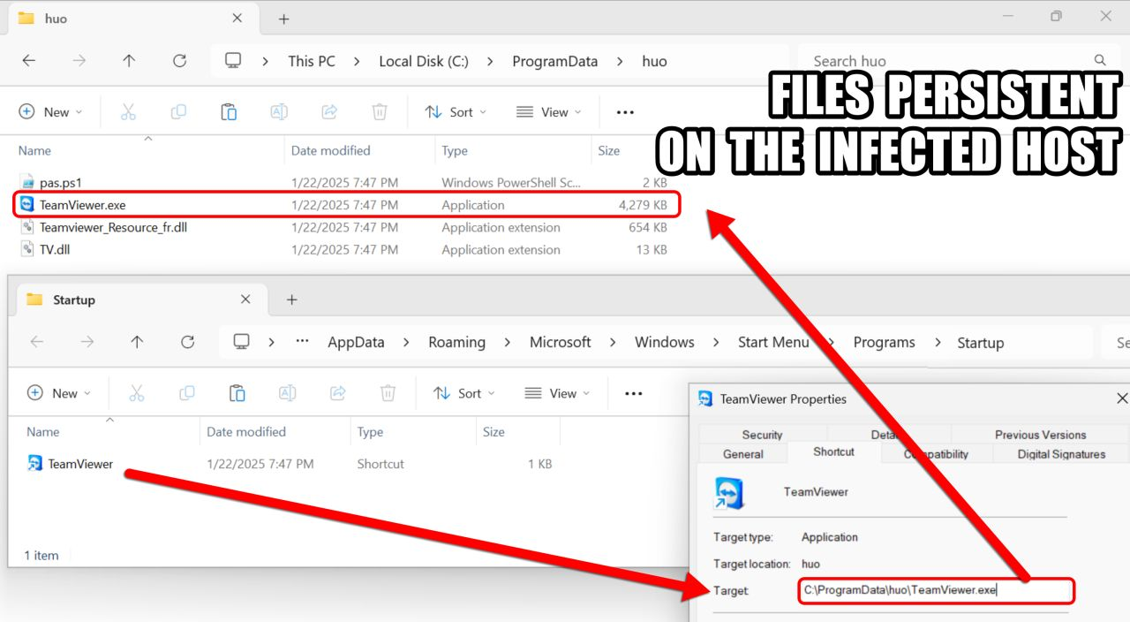
Social Media Links

Slide 17
Identification
Objective: Confirm the incident and gather initial information.
Actions:
Analyze Traffic
Gather Information and Verify Information - MITRE ATT&CK
Malware Behavior Analysis
Notes:
Diego

Slide 18
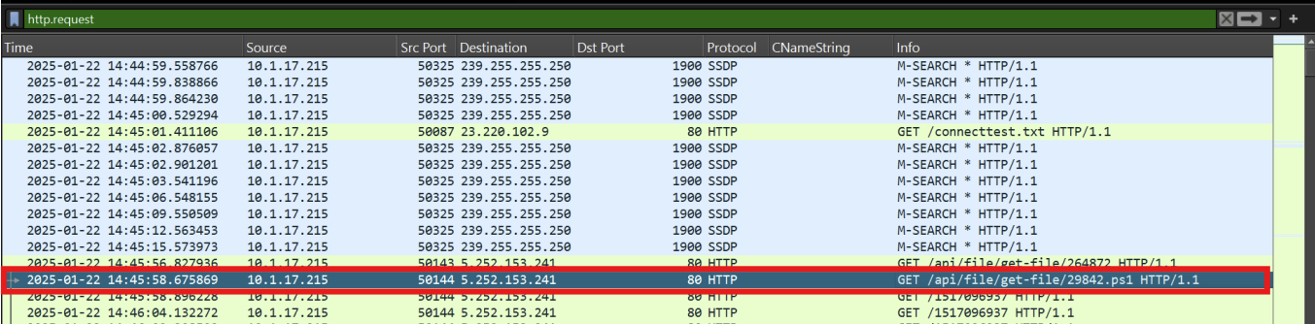
Analyze Traffic Using Wireshark
Identifying the victim.
Http.request
This tells you someone made a web request.

Slide 19
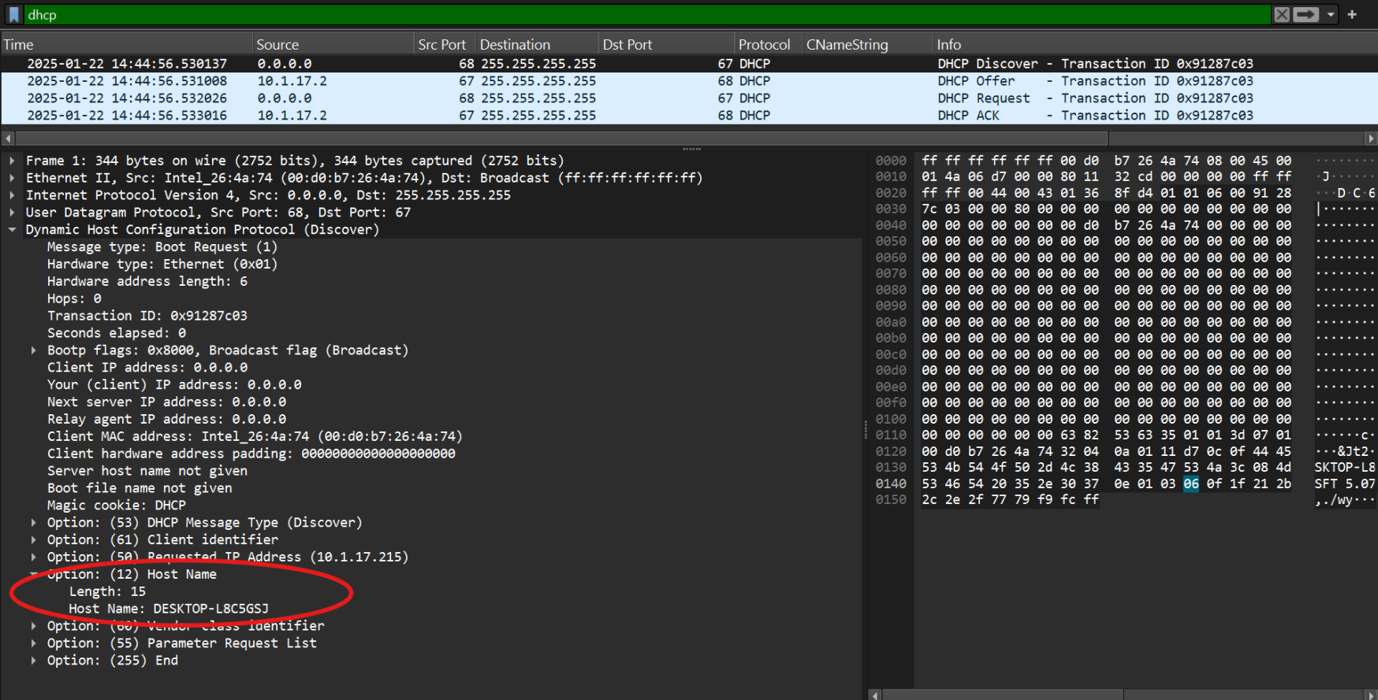
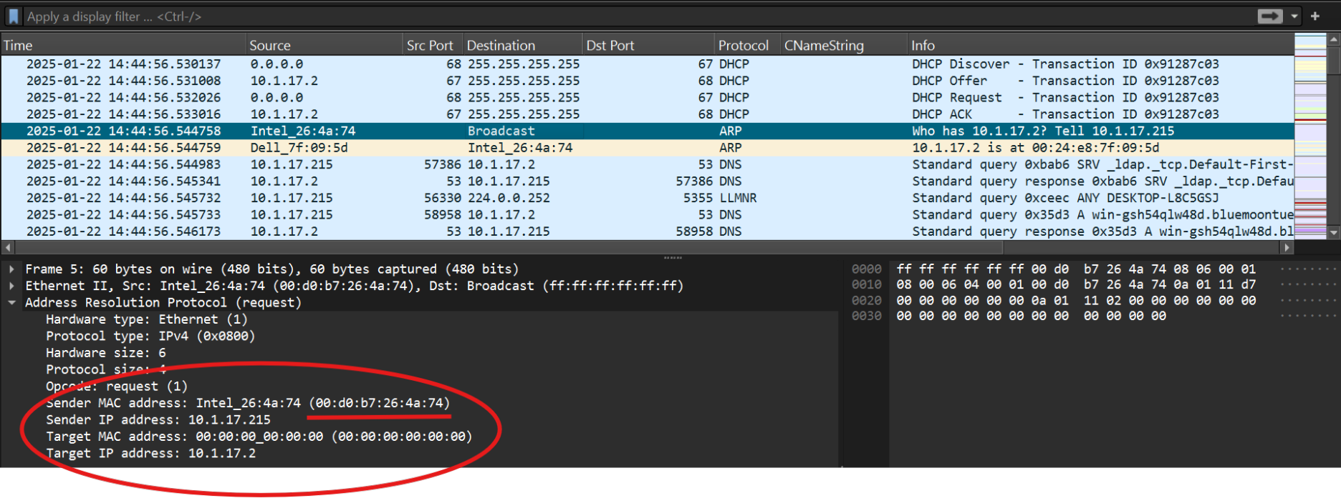
Analyze Traffic
Identifying the victim.
The MAC address helps you identify the exact device that made the request on the network.
DHCP logs show the hostname assigned to a device when it joined the network.

Slide 20
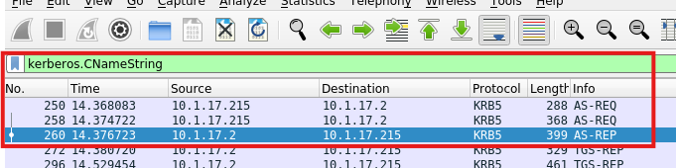
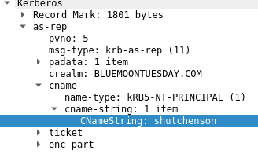
Analyze Traffic
Identifying the victim.
Kerberos is a network authentication protocol used primarily in Windows Active Directory (AD) environments.
The employee who was using the computer

Slide 21
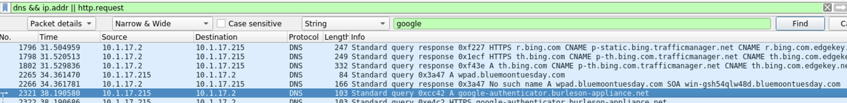
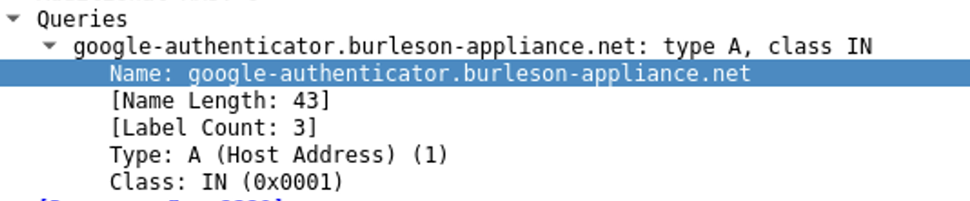
Analyze Traffic
Identifying the attacker.

Slide 22
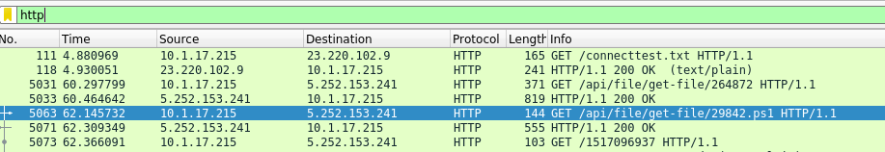
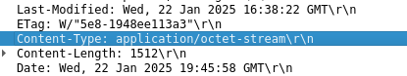
Analyze Traffic
Identifying the attacker.
Analyze outbound GET requests for potential installations
Confirm if victim downloaded the malware

Slide 23
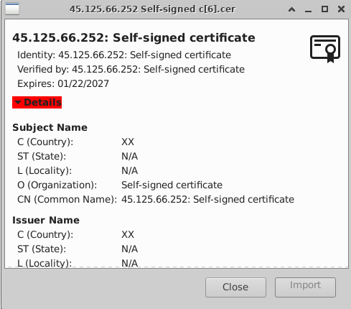
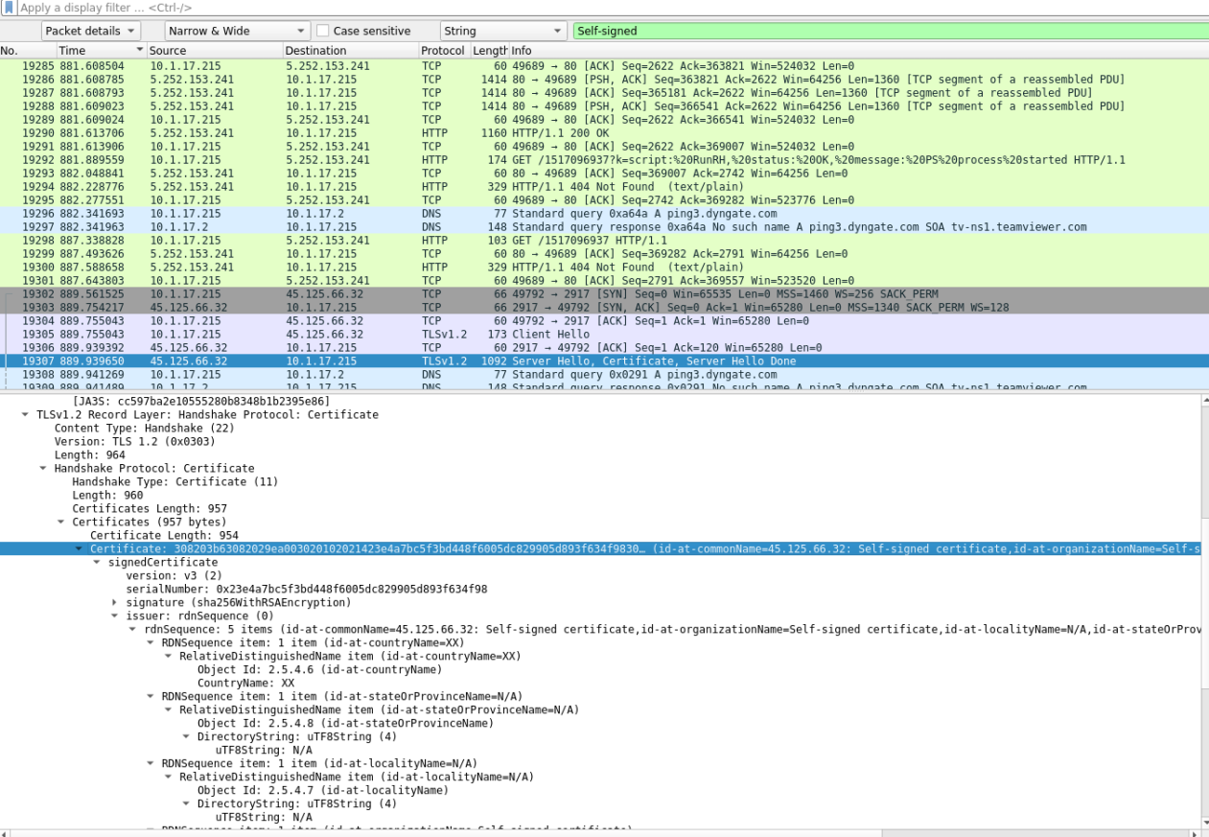
Analyze Traffic
Notes:
Aaroha

Slide 24
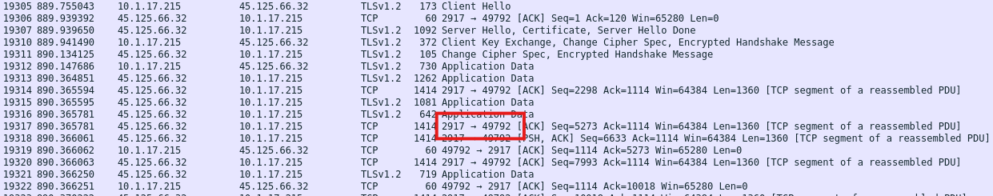
Analyze Traffic

Slide 25
Analyze Traffic
Attacker IPs:
5.252.153.241 (Downloading and Installing PS)
45.125.66.252 (Likely C2 Server for Remote Session)
45.125.66.32 (Likely C2 Server for Remote Session)

Slide 26
MITRE ATT&CK
Framework
Help find malware/ bad IPs

Slide 27
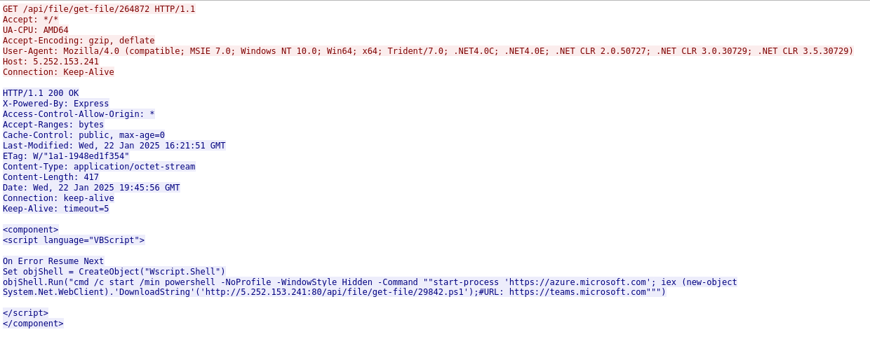
Initial Access
Malicious VBScript is used to run hidden PowerShell commands via a Windows shell.
Script downloads and executes a PowerShell file (29842.ps1) from a suspicious IP (5.252.153.241).
Behavior matches MITRE ATT&CK techniques like T1059.001 (PowerShell execution), T1059.005 (VBScript execution), T1105 (Remote file download), T1204 (User Execution)

Slide 28
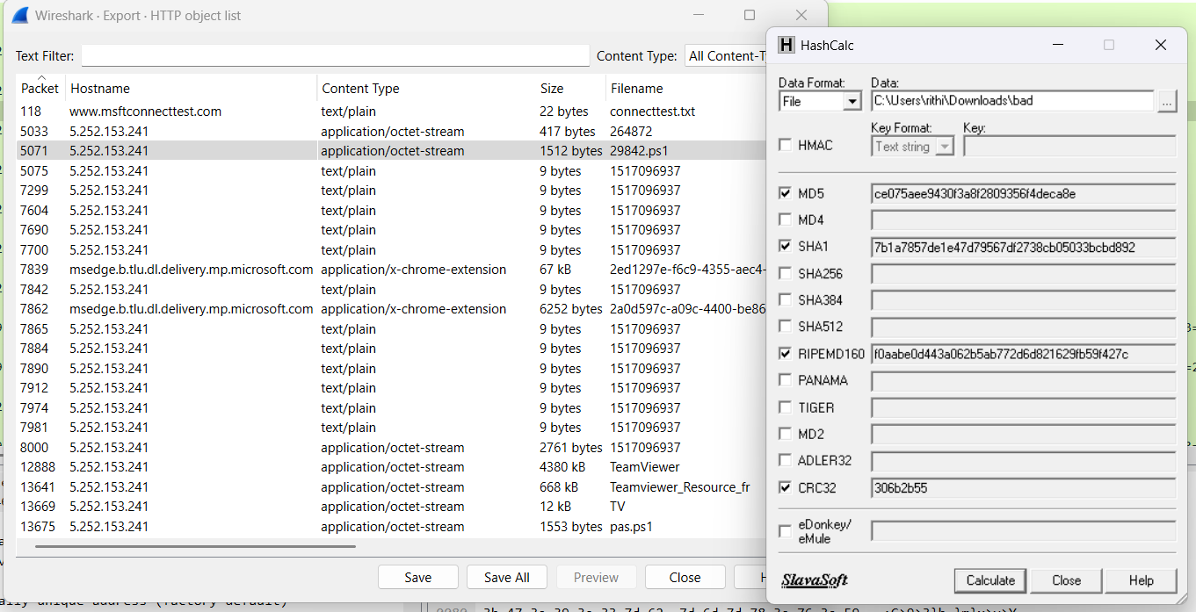
Identified a suspicious file: 29842.ps1
Using HashCalc to calculate the file’s SHA1 hash

Slide 29
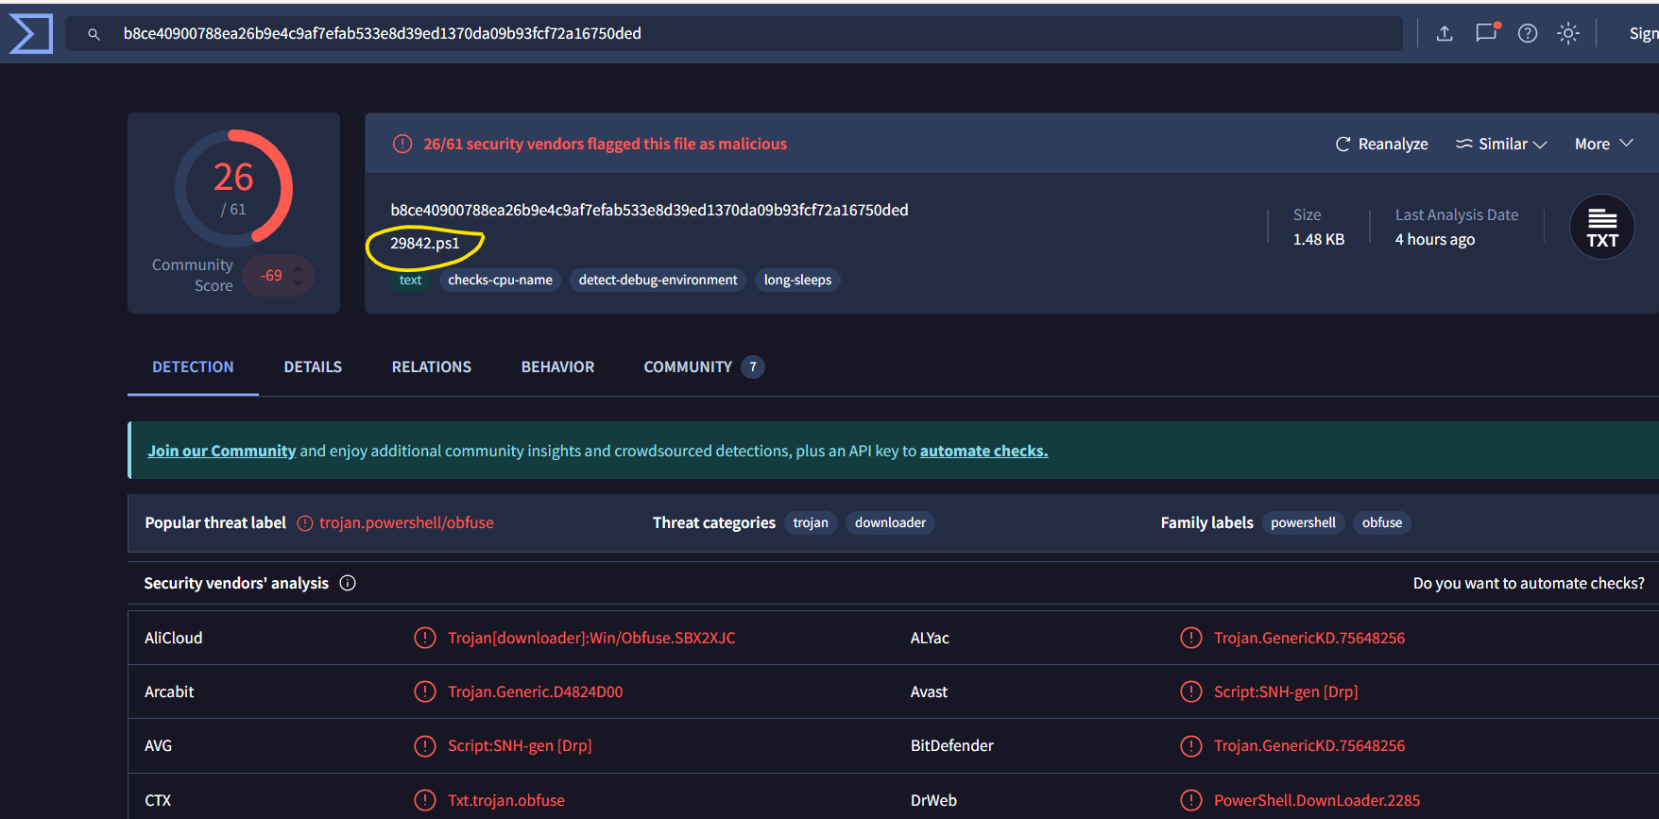
Submitted the hash to VirusTotal
29842.ps1 is confirmed to be a malicious PowerShell script
Identified as a Trojan downloader

Slide 30
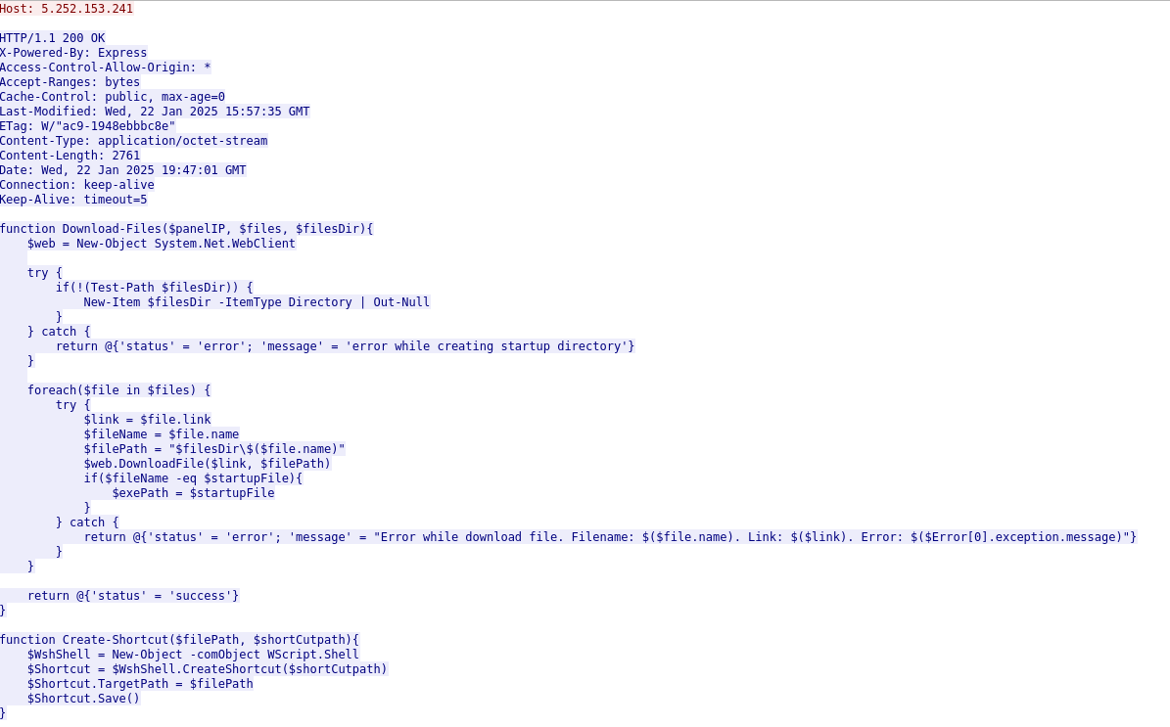
Execution
T1059 - Powershell
Malicious PowerShell Script Execution.

Slide 31
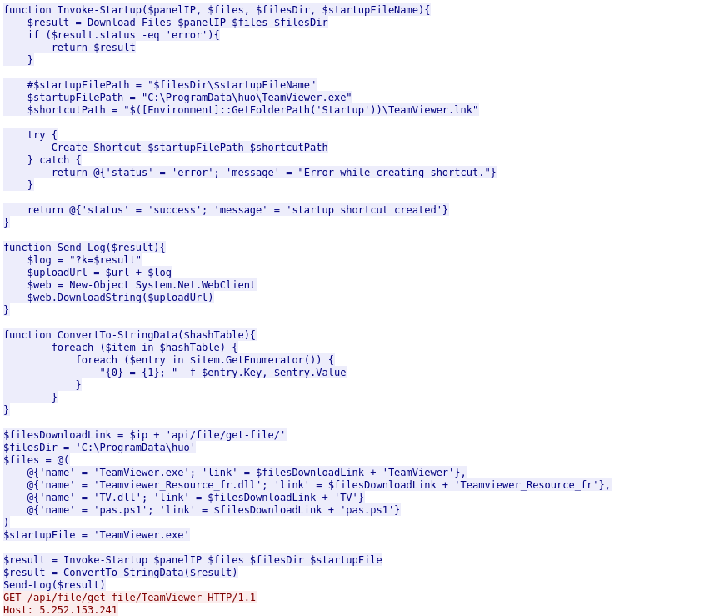
Execution

Slide 32
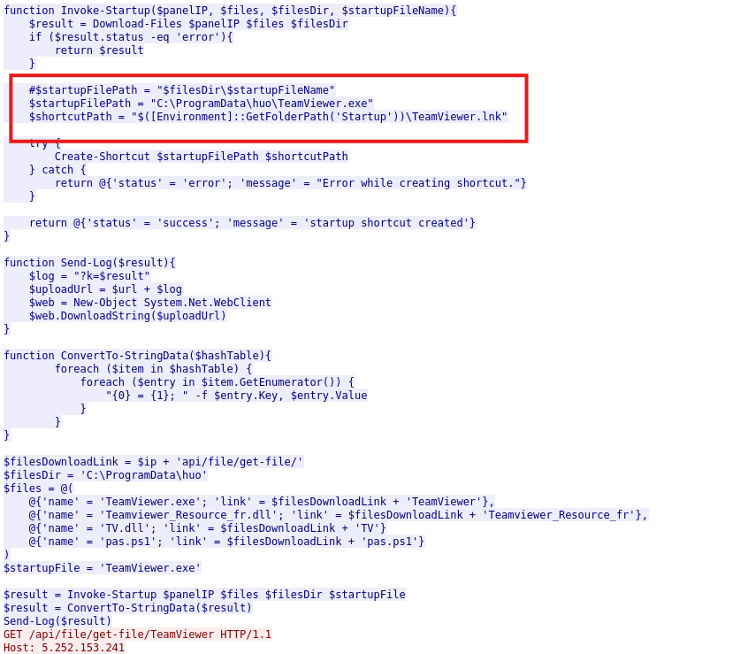
Persistence
T1547 - Registry Run Keys / Startup Folder
Creates a shortcut to execute TeamViewer at System Startup.

Slide 33
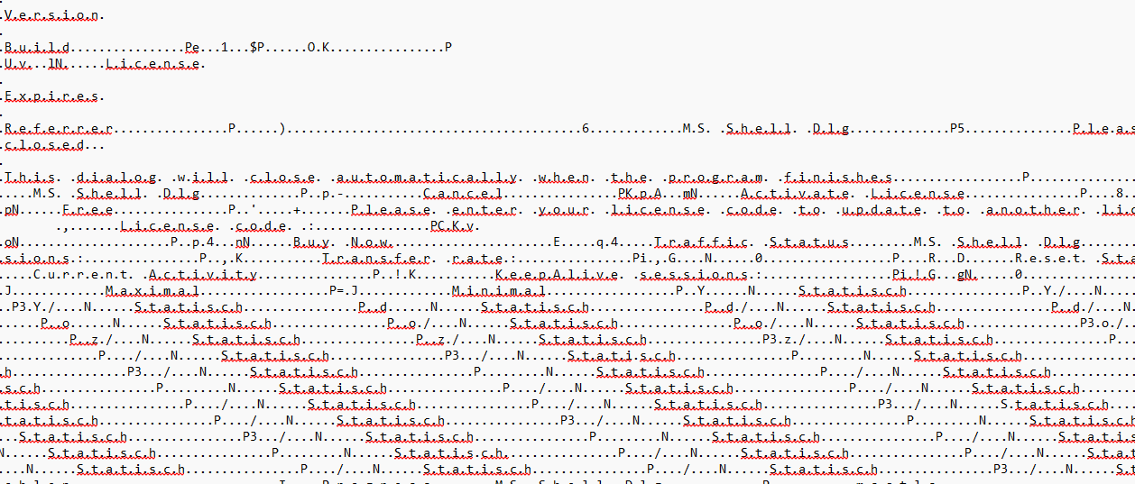
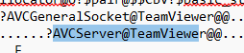
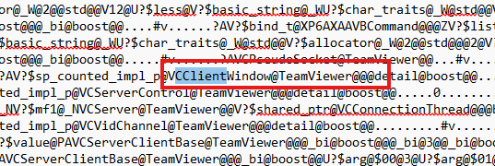
Defense Evasion
T1027 - Obfuscated Files or Information
Heavy use of Base64 and string mangling.

Slide 34
Command & Control
T1071 - Web Protocols
HTTP-based C2 with custom endpoints delivering payloads like .ps1

Slide 35
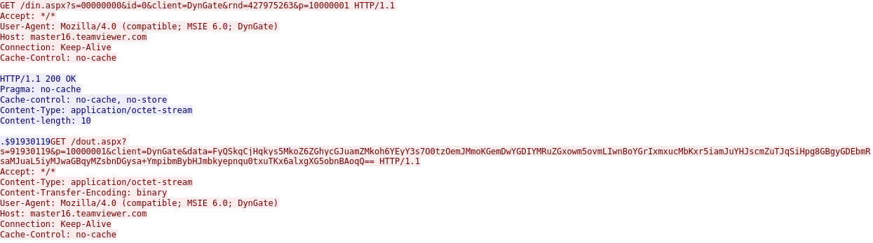
Impact
T1569 - Service Execution
Potential remote execution/control via TeamViewer

Slide 36
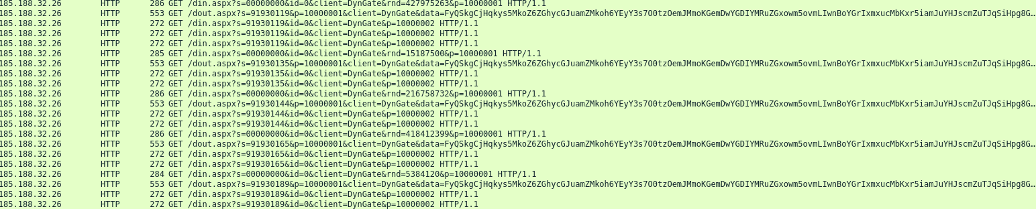
Impact
T1569 - Service Execution
Potential remote execution/control via TeamViewer

Slide 37
Malware Behaviour Analysis
PowerShell Payload
Create Shortcut
Silent Execution
Remote Access
29842.ps1
Downloads multiple components from
http://5.252.153.241/api/file/get-file/
TeamViewer.exe in C:\ProgramData\huo\
.lnk file in startup directory
Using Hidden Powershell Windows Sending Logs to C2
Potential execution and Run of TeamViewer without GUI.
Potential Use DynGate protocol for Unauthorized Remote Access

Slide 38
Incident Impact
Severity: High
Malware downloaded after visiting a fake website (authenticatoor.org)
Potential Damage:
Data Loss: Theft or deletion of sensitive data.
Reputation Damage: Data leaks or breaches leading to loss of trust.
Business Disruption: Downtime affecting operations.
Network Compromise: Lateral movement and further infections across the network.
Affected Systems:
Victim System: DESKTOP-L8C5GSJ (IP: 10.1.17.215)
AD/Domain: Risk to BLUEMOONTUESDAY domain and critical services (e.g., Domain Controllers).

Slide 39
Incident Response Process

Slide 40
Incident Response Process
Step-by-step response based on our playbook
Preparation: Trained SOC Analysts and updated security tools/ Developed communication plan.
Identification: Documented initial report and analyzed pcap for IOCs/ Cross-referenced with known malicious indicators.
Containment: Isolated infected system and blocked malicious domains/IPs/ Disabled user account.
Eradication: Ran antivirus tools to remove malware/Applied patches to prevent reinfection.
Recovery: Reimaged system and restored data/ Monitored for reinfection.
Lessons Learned: Reviewed incident for improvements/ Updated playbook and shared findings with team.
Notes:
“In response to the incident, we followed our well-defined playbook step by step to ensure an effective and structured resolution.
During Preparation, our SOC analysts were trained and ready, supported by up-to-date security tools and a clear communication plan.
In the Identification phase, we documented the initial report and analyzed the packet capture to look for indicators of compromise. These were then cross-referenced with known malicious indicators.
For Containment, we acted quickly to isolate the infected Windows client, blocked known malicious domains and IP addresses, and disabled the associated user account to prevent further spread.
During Eradication, we ran antivirus tools to fully remove the malware and applied necessary patches to mitigate vulnerabilities.
In Recovery, we reimaged the system, restored the data from backups, and continued monitoring for any signs of reinfection.
Finally, in the Lessons Learned phase, we conducted a thorough review of the incident, updated our playbook accordingly, and shared our findings with the rest of the team to enhance future response efforts.

Slide 41
Incident Response Process
Indicators of compromise (IOCs) found in the dataset:
IP Addresses:
10.1.17.215 – Infected Windows client
5.252.153.241 – Likely used for initial malicious download
45.125.66.32 – Used post-download, possibly C2 communication (PowerShell activity)
45.125.66.252 – Additional suspected C2 server
Domains:
google-authenticator.burleson-appliance.net
Fake Google Authenticator phishing domain
Traffic Patterns:
Suspicious DNS request to fake domain
HTTP request to download a malicious file from 5.252.153.241
TCP communication from infected host (10.1.17.215) to 45.125.66.32 and 45.125.66.252 immediately after file download, indicating possible C2 activity
Notes:
“During the investigation, we identified several key indicators of compromise in the dataset.
The infected host was at IP address 10.1.17.215. It reached out to 5.252.153.241, likely to download the initial malicious payload.
Following the download, we observed PowerShell-related traffic to 45.125.66.32 and 45.125.66.252, both likely command-and-control servers.
We also saw a suspicious DNS request to a fake domain—google-authenticator.burleson-appliance.net—designed to mimic Google Authenticator for phishing purposes.
Shortly after that, an HTTP request was made to download malware, followed by immediate outbound TCP connections to the suspected C2 servers, indicating active compromise and remote communication.”

Slide 42
Remediation Strategies
Immediate Countermeasures:
Block malicious domains/IPs (authenticatoor.org).
Isolate infected systems to prevent lateral movement.
Temporarily disable the user account linked to the infection.
Long-Term Prevention:
Deploy Endpoint Detection and Response (EDR) tools.
Regular patching of systems to address vulnerabilities.
Enforce Multi-Factor Authentication (MFA) across systems.
User Education:
Conduct regular phishing awareness training.
Educate users on identifying fake websites and malware risks.
Notes:
“In terms of immediate response, we blocked the malicious domains and IPs involved, including the phishing domain and all associated C2 servers. We isolated the infected machine to prevent lateral movement and disabled the affected user account.
For long-term prevention, we’re recommending the deployment of EDR tools for continuous endpoint visibility and faster response. We’re also enforcing regular system patching and rolling out multi-factor authentication organization-wide.
Lastly, user education plays a huge role—so we’ll continue conducting phishing awareness training and guiding users on how to recognize fake websites and malware risks.
Together, these measures strengthen our ability to respond quickly, recover fully, and reduce the chance of future incidents.”

Slide 43
Conclusion
SUMMARY
Found evidence of malicious C2 server IPs by analyzing the PowerShell script installation and execution.
Attacker uses remote access trojan posing as TeamViewer to gain access to victim’s machine using TV.dll which runs at startup
Teamviewer can be exploited to disable system protections
CONCERNS
Privilege escalation: Attacker could gain administrative access, compromising sensitive data, disable security measures, etc.
Lateral movement: C2 commands could be sent to other network devices
Persistence mechanism: Attacker can create backdoors such as additional users to maintain access even if malware is “removed”

Slide 44
Lessons Learned
Malware is often fragmented and built to evade detection and remediation, calling for robust analysis and countermeasures
A structured playbook ensures the efficient handling of cybersecurity incidents, outlining the who,what,when, where and why of the attack
Early prevention with user education, system hardening and monitoring is crucial as RATs can compromise an entire organization
Further tools and strategies can be used to identify how the malware interacts with the system on the local level (EDR, FIM)

Slide 45
Thank You!

